Slide 1
DOCKER COMMANS AND NOTES
ORIOL ORDI

Slide 2
INDEX
INSTALLATION AND ACTIVATION
0. INSTALLATION
0. ACTIVATION
RUNNING IMAGES AND PLAYING WITH CONTAINERS
1. PULL
2. RUN
3. IMAGES
4. PS
5. START
6. STOP
7. RM
8. RMI
9. CONTAINER RENAME
10. EXECUTING COMMANDS WITH RUN
11. EXECUTING COMMANDS WITH EXEC
12. RUN (ATTACHED AND DETACHED)
13. VERSION
14. RUN OR EXEC (INTERACTIVE MODE)
15. RUN OR EXEC (ATTACHED TERMINAL)
16. RUN (WITH PORT MAPPING)
16. RUN (WITH VOLUME)
16. RUN (WITH MOUNT)
17. RUN (ENVIRONMENT VARIABLES)
18. INSPECT
19. LOGS

Slide 3
INDEX
CREATING IMAGES
20. BUILD
21. PUSH
22. DOCKERFILE
23. CMD AND ENTRYPOINT
NETWORKS
24. NETWORKS
STORAGE
25. STORAGE
LINKING
26. LINK
DOCKER-COMPOSE
27. DOCKER COMPOSE
REGISTRY
28. REGISTRY
29. PRIVATE REGISTRY
30. DEPLOY YOUR OWN PRIVATE REGISTRY
ENGINE
31. DOCKER ENGINE
CONTAINER ORCHESTRATION TOOLS
32. CONTAINER ORCHESTRATION TOOLS

Slide 4
INSTALLATION AND ACTIVATION

Slide 5
0. INSTALLATION
Download and install windows docker from here: https://docs.docker.com/docker-for-windows/install/
This is the installer for WINDOWS 10 PRO, but in the web there are installers for other versions
To install docker in Ubuntu, follow these instructions: https://docs.docker.com/engine/install/ubuntu/
For any other OS, check on the docks.docker.com documentation

Slide 6
0. ACTIVATION
To start running docker:
On windows: Open the Docker Desktop program and make it start running.
On ubuntu: sudo service docker start or sudo systemctl start docker

Slide 7
RUNNING IMAGES AND PLAYING WITH CONTAINERS

Slide 8
1. PULL
PULL downloads an image from the dockerhub registry
USAGE
docker pull IMAGE_NAME

Slide 9
2. RUN
RUN runs an image in a container (creates a container from an image)
The container is only active while the process it’s executing is active, then it stops
Some processes are always active and have to be stopped manually, though
USAGE
docker run –-name=CONTAINER_NAME IMAGE_NAME
docker run IMAGE_NAME:tag → runs the specific version of the image (if ignored tag=latest by default)
EXAMPLE: docker run redis:4.0-buster
Optional

Slide 10
3. IMAGES
IMAGES returns a list of pulled images
USAGE
docker images

Slide 11
4. PS
PS returns a list of running containers with information such as:
Container_id, Image, Command, Ports, Container_name…
USAGE
docker ps
FLAGS
docker ps –a → returns a list of all containers (running or not)

Slide 12
5. START
START starts a container that is not running
USAGE
docker start CONTAINER_NAME_OR_CONTAINER_ID
ALTERNATIVES
docker container start CONTAINER_ID
docker container start $(docker ps –aqf “name=CONTAINER_NAME”)

Slide 13
6. STOP
STOP stops a container that is running
USAGE
docker stop CONTAINER_NAME_OR_CONTAINER_ID
ALTERNATIVES
docker container stop CONTAINER_ID
docker container stop $(docker ps –aqf “name=CONTAINER_NAME”)

Slide 14
7. RM
RM deletes a stopped container
USAGE
docker rm CONTAINER_NAME_OR_CONTAINER_ID
ALTERNATIVES
docker container rm CONTAINER_ID
docker container rm $(docker ps –aqf “name=CONTAINER_NAME”)

Slide 15
8. RMI
RMI deletes an image
All containers based on that image have to have been deleted before
USAGE
docker rmi IMAGE_NAME_OR_IMAGE_ID

Slide 16
9. CONTAINER RENAME
CONTAINER RENAME renames a container
USAGE
docker container rename OLD_CONTAINER_NAME NEW_CONTAINER_NAME

Slide 17
10. EXECUTING COMMANDS WITH RUN
RUN can be followed by a command to execute when the container is created
USAGE
docker run IMAGE_NAME COMMAND
EXAMPLE
docker run ubuntu sleep 5 → runs an Ubuntu container and executes the command sleep for 5 seconds

Slide 18
11. EXECUTING COMMANDS WITH EXEC
EXEC can be used on a running container to execute a command
USAGE
docker exec CONTAINER_NAME COMMAND
EXAMPLE
docker exec silly_dog cat /etc/hosts → runs the “cat /etc/hosts” command on the silly_dog container

Slide 19
12. RUN (ATTACHED AND DETACHED)
RUN by default runs a container in an ATTACHED mode
This means that you are attached to the console (or standard out) of the container and you won’t be able to do anything on your console until the docker container stops, or you press CTRL+C
Alternatively, you can run a container in a DETACHED mode with the –d flag
This will run the docker container in a background mode, freeing the console for you
RUN A DETACHED CONTAINER → docker run –d IMAGE_NAME
ATTACH A DETACHED CONTAINER → docker attach CONTAINER_NAME_OR_ID

Slide 20
13. VERSION
VERSION is used to know the version of docker installed
Also to know whether docker is installed correctly and it works
USAGE
docker version

Slide 21
14. RUN OR EXEC (INTERACTIVE MODE)
RUN by default runs the container and it does not listen to input
If we want to use some input because the application needs it, we need to run in interactive mode with -i
USAGE
docker run -i IMAGE_NAME
Also works with exec

Slide 22
15. RUN OR EXEC (ATTACHED TERMINAL)
RUN by default doesn’t attach a terminal
If we want to attach a pseudo-terminal, we need to run in pseudo-terminal mode with -t
This can be used in conjunction with interactive mode to have an interactive terminal
USAGE
docker run -it IMAGE_NAME
Also works with exec

Slide 23
16. RUN (WITH PORT MAPPING)
RUN can be used in conjunction with port mapping
Port mapping maps the port of the docker container to a port of the docker host
This way you can run multiple instances of an app and map them to different ports of the docker host
USAGE
docker run -p PORT_ON_HOST:PORT_ON_CONTAINER IMAGE_NAME
EXAMPLE: docker run -p 3655:8080 puckel/docker-airflow

Slide 24
16. RUN (WITH VOLUME)
RUN can be used in conjunction with a volume
A volume is a mapping of a directory in the host system with a directory in the docker container
This mapping allows files to be shared between both directories
USAGE
docker run -v VOLUME_PATH_IN_HOST:VOLUME_PATH_IN_CONTAINER IMAGE_NAME
EXAMPLE: docker run -v /mnt/c/Users/Usuario/Desktop/Data:/usr/local/airflow puckel/docker-airflow

Slide 25
16. RUN (WITH MOUNT)
It’s the same as run with volumen, but with different syntax
docker run --mount type=bind,source=VOLUME_PATH_IN_HOST,target=VOLUME_PATH_IN_CONTAINER IMAGE_NAME
EXAMPLE: docker run --mount type=bind,source=/mnt/c/Users/Usuario/Desktop/Data,target=/usr/local/airflow puckel/docker-airflow

Slide 26
17. RUN (ENVIRONMENT VARIABLES)
RUN can also pass environment variables at creation
To do so, use the flag –e or –env followed by the environment variable name
USAGE
docker run -e VARIABLE_NAME=VARIABLE_VALUE IMAGE_NAME
EXAMPLE: docker run -e COLOR=“blue” puckel/docker-airflow

Slide 27
18. INSPECT
INSPECT returns all details of a container in JSON format (including environment variables, under Config → ENV)
USAGE
docker inspect CONTAINER_NAME_OR_CONTAINER_ID

Slide 28
19. LOGS
LOGS returns logs of a container
USAGE
docker logs CONTAINER_NAME_OR_CONTAINER_ID

Slide 29
CREATING IMAGES

Slide 30
20. BUILD
INSPECT builds an image from a dockerfile
USAGE
docker build DOCKERFILE_NAME –t IMAGE_NAME
The –t flag is used to give the image a name

Slide 31
21. PUSH
PUSH uploads an image to the dockerhub registry
USAGE
docker push IMAGE_NAME

Slide 32
22. DOCKERFILE
The DOCKERFILE is used to build a docker image
Example and notes of a dockerfile on the next 2 pages:

Slide 33
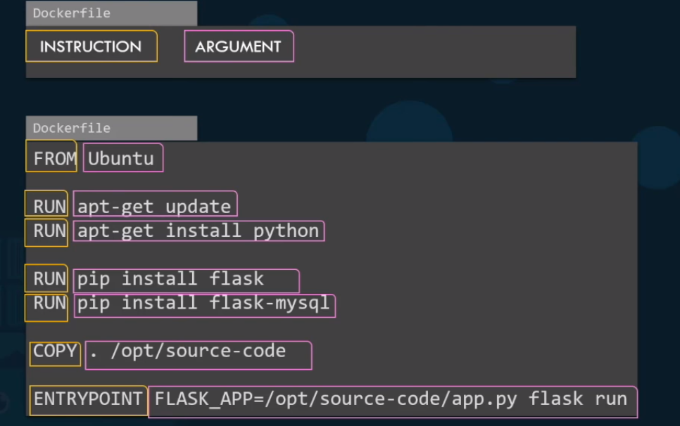
22. DOCKERFILE

Slide 34
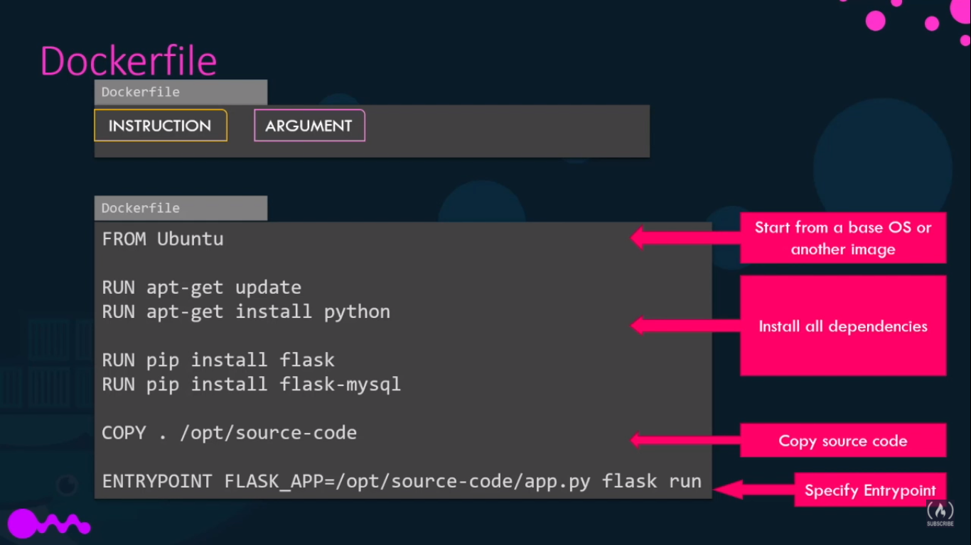
22. DOCKERFILE

Slide 35
23. CMD AND ENTRYPOINT
CMD specifies a command to run when “docker run IMAGE_NAME” is called
If there’s a command at runtime (“docker run IMAGE_NAME COMMAND”) it gets replaced
ENTRYPOINT specifies a command to run when docker run IMAGE_NAME is called
If there’s a command at runtime (“docker run IMAGE_NAME COMMAND”) it gets appended
Check on the next page for examples
Note: CMD and ENTRYPOINT can be both used

Slide 36
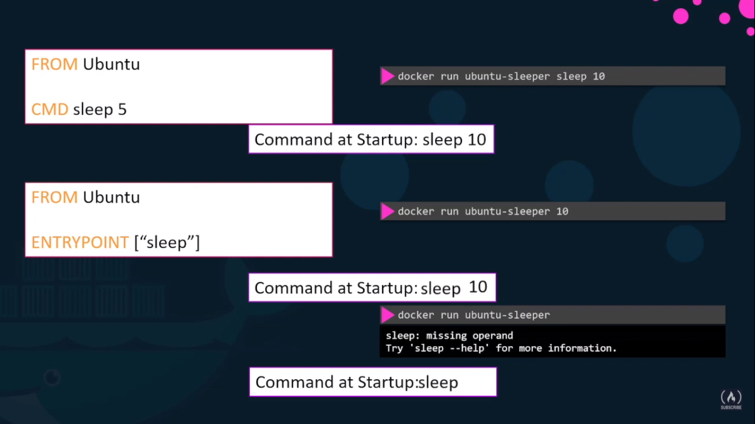
23. CMD AND ENTRYPOINT

Slide 37
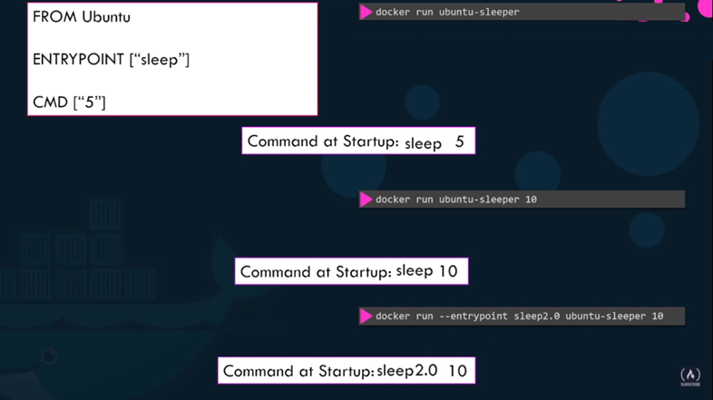
23. CMD AND ENTRYPOINT

Slide 38
NETWORKS

Slide 39
24. NETWORKS
There are 3 default networks on docker
BRIDGE (default): Each container gets its network, which can be mapped to the host via port mapping
NONE: The container does not have any access to network
HOST: The container uses the host network and ports
Check the next page to see how to use each one

Slide 40
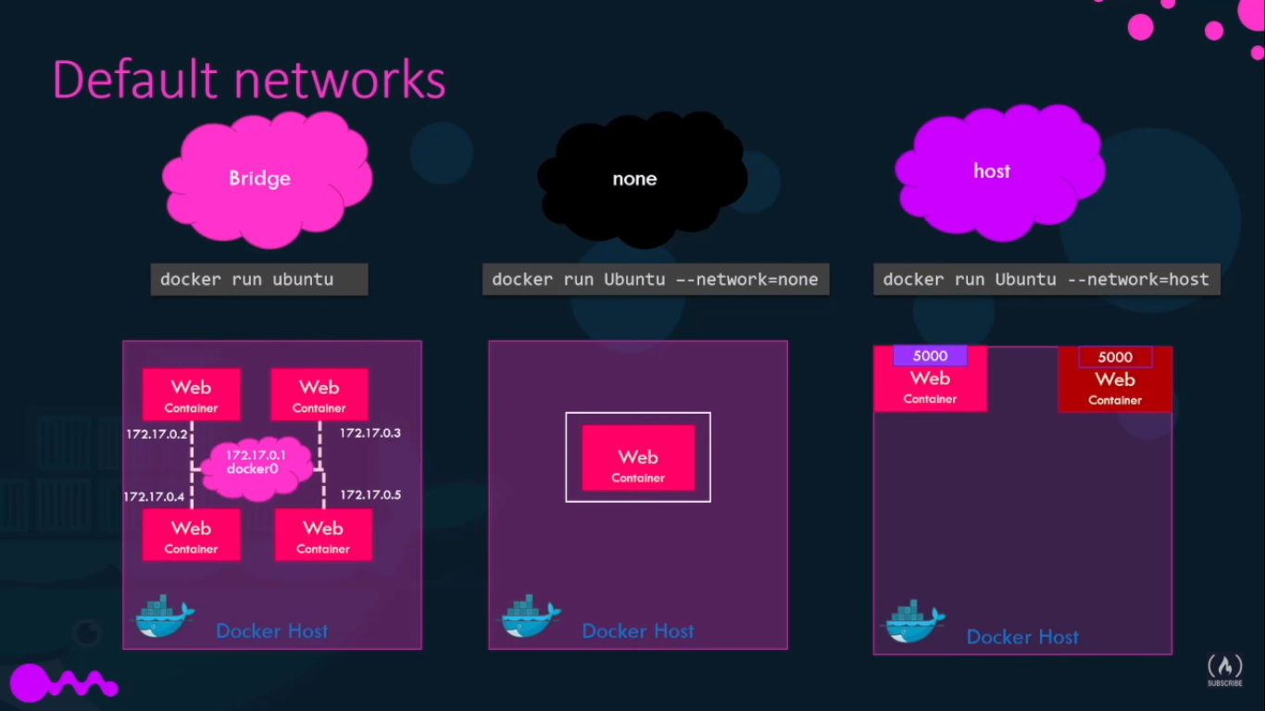
24. NETWORKS

Slide 41
STORAGE

Slide 42
25. STORAGE
Docker is stored in the following directory: /var/lib/docker

Slide 43
LINKING

Slide 44
26. LINK
RUN be used to link containers with the –-link flag
USAGE
docker run --link NAME_OF_CONTAINER_TO_LINK:NAME_OF_HOST IMAGE_NAME
EXAMPLE: docker run --link redis:redis IMAGE_NAME

Slide 45
DOCKER-COMPOSE

Slide 46
27. DOCKER COMPOSE
DOCKER COMOPOSE can be used to run various containers and make connections between them
To do so, we need to create a .yml file named docker-compose.yml
And then run the command “docker-compose up” in the directory where that file is
Note: running the command “docker-compose down” will remove all containers and delete all images
(and pull all necessary images)
* Example of a docker compose file in a few slides

Slide 47
27. DOCKER COMPOSE
DOCKER COMOPOSE doesn’t actually NEED the file to be named docker-compose.yml
It will just automatically execute that file when running the command “docker-compose up”
However, if the file has another name, we can specify the file name with the following command:
“docker-compose –f FILENAME.EXTENSION up”

Slide 48
27. DOCKER COMPOSE
Once ”docker-compose up” has been executed, the images specified in the file will be pulled and containers for each image will be created (as well as connections between containers if specified)
After that, we can play around with all the containers in the same way as docker but with docker-compose
EXAMPLE 1: docker-compose stop → stops all containers from the docker-compose
EXAMPLE 2: docker-compose start → starts all containers from the docker-compose
EXAMPLE 3: docker-compose rm → removes all containers from the docker-compose

Slide 49
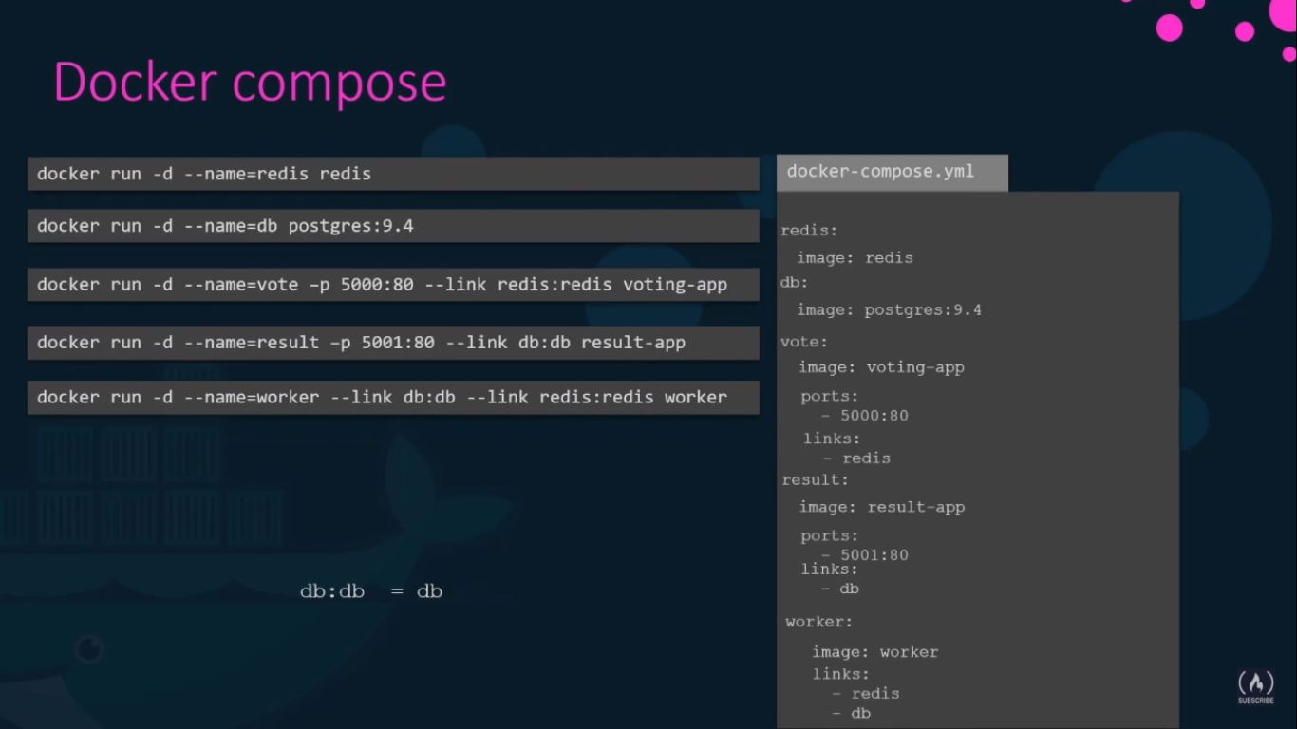
27. DOCKER COMPOSE
This is an example of a docker compose file.
In the right we see the docker compose file.
In the left, the equivalent sequence of docker commands.

Slide 50
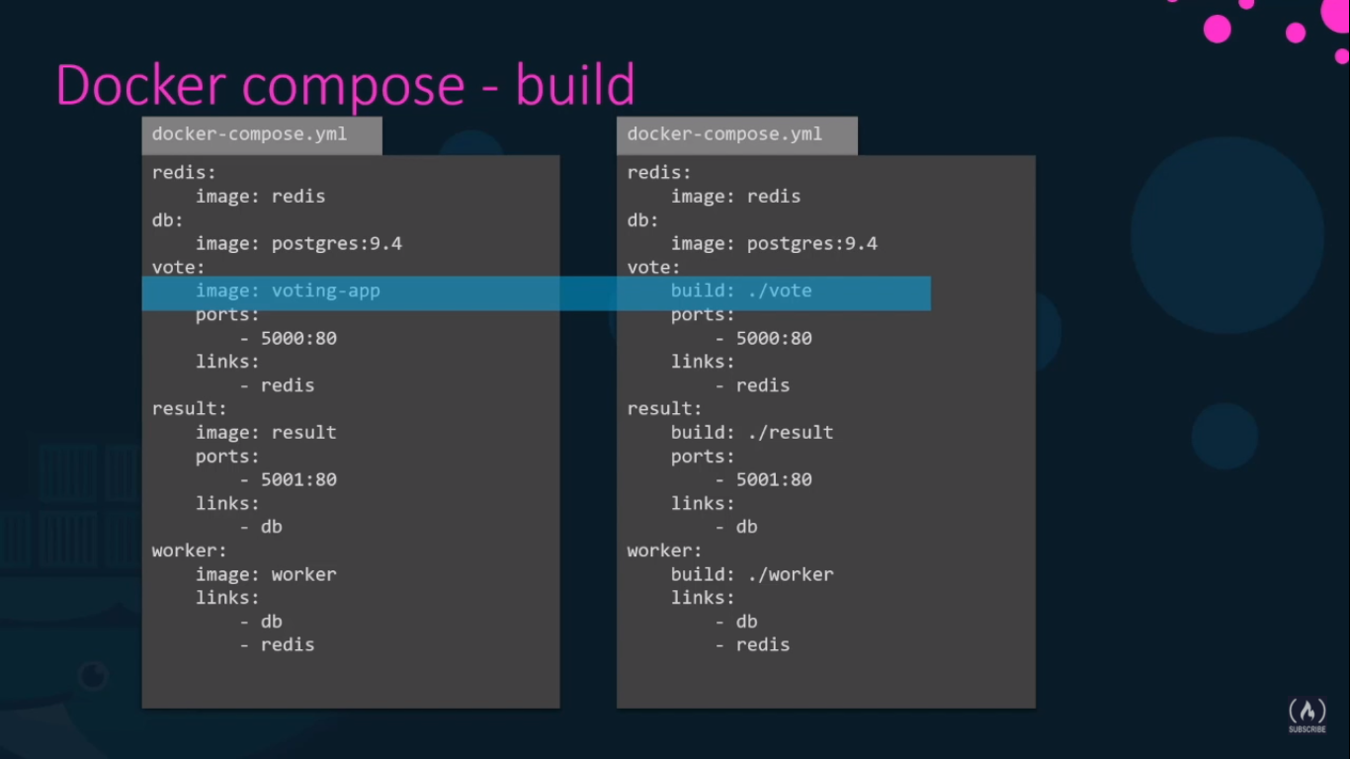
27. DOCKER COMPOSE
We can specify a build instead of a dockerhub registry image pull, by passing a directory containing the DOCKERFILE and all the necessary things to build an image

Slide 51
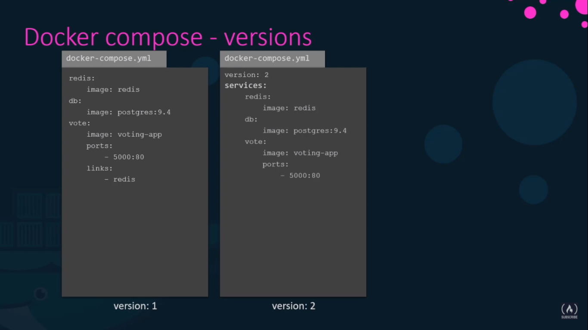
27. DOCKER COMPOSE
VERSIONS
In version 2, docker automatically creates a dedicated network for all the services and connects them all to each other, meaning there is no need to specify links

Slide 52
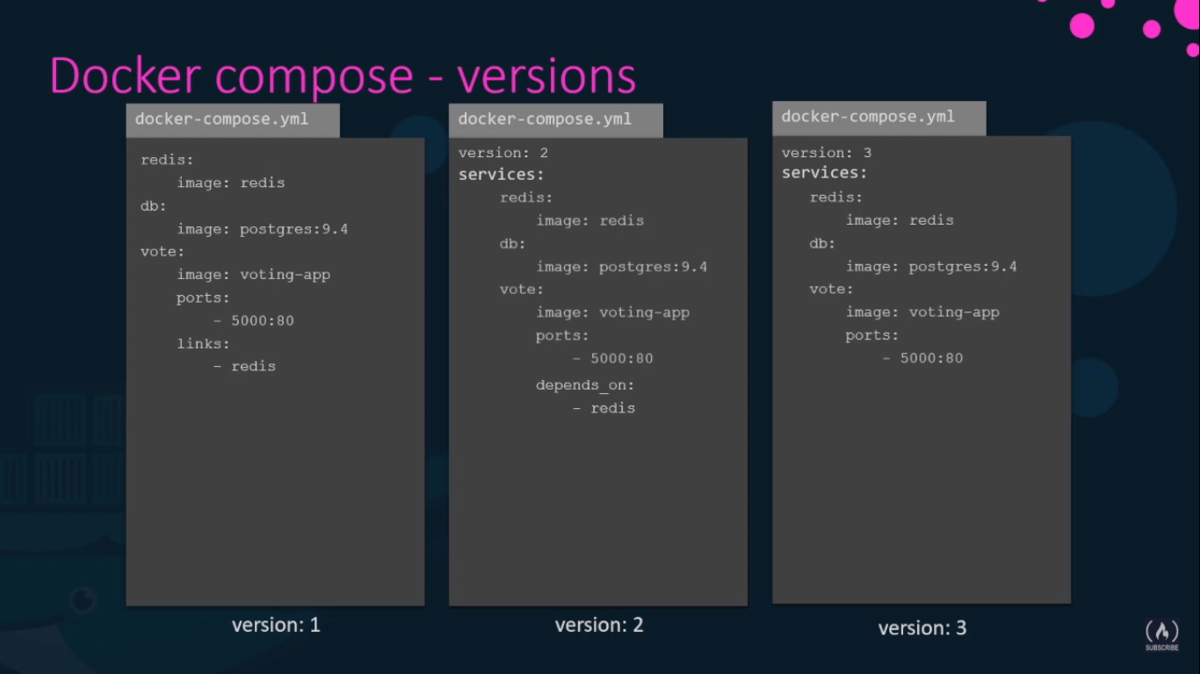
27. DOCKER COMPOSE
VERSIONS
In version 3 PENDING

Slide 53
REGISTRY

Slide 54
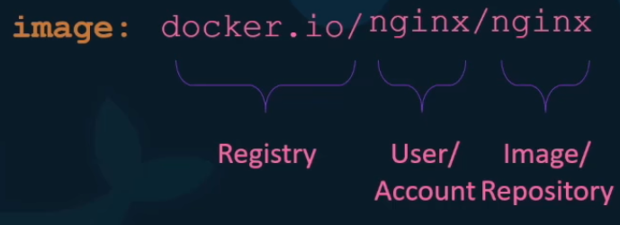
28. REGISTRY
When you pull an image, and you only write the name of the image, for example, “docker pull nginx”
Docker automatically expands to use docker.io as the registry and the same name for user and image
So, in that case, docker assumes what you mean is docker.io/nginx/nginx and pulls the image from there
Otherwise you can specify a different PUBLIC registry or a different user/account
For example, “docker pull puckel/docker-airflow” will be assumed to be docker.io/puckel/docker-airflow
And “docker pull g-registry.io/testuser/testimage” will pull from g-registry.io/testuser/testimage

Slide 55
29. PRIVATE REGISTRY
You can also login into a private registry with docker login
EXAMPLE: docker login private-registry.io
Logging in to a private registry may need a password
And then pull an image from there: docker pull private-registry/apps/internal-app

Slide 56
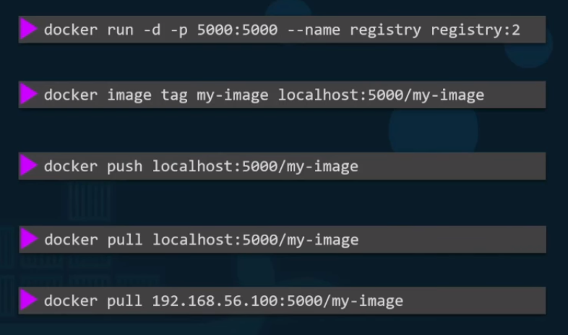
30. DEPLOY YOUR OWN PRIVATE REGISTRY
The docker registry is itself another application and is available as a docker image
The name of the image is “registry” and it exposes the API on port 5000
Run the registry
Create the image in the registry
Push into the registry
Pull from the registry from the host
Pull from the registry from another machine
in the same network (the IP is the IP of the host)

Slide 57
ENGINE

Slide 58
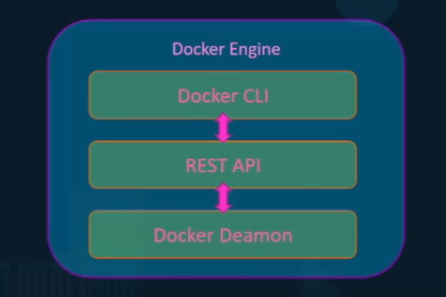
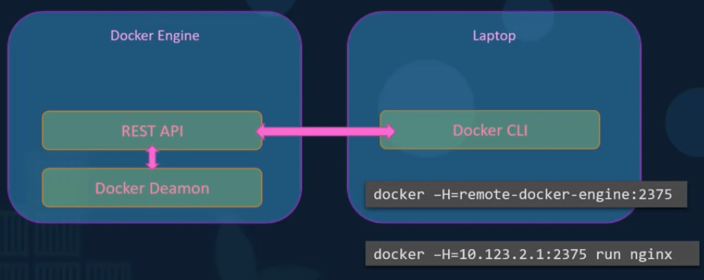
31. DOCKER ENGINE
Docker engine is a host with docker installed on it
The docker installation consists of the docker daemon, the rest api, and the docker cli
The docker cli can be somewhere else and run commands on an external host with the –H flag

Slide 59
CONTAINER ORCHESTRATION

Slide 60
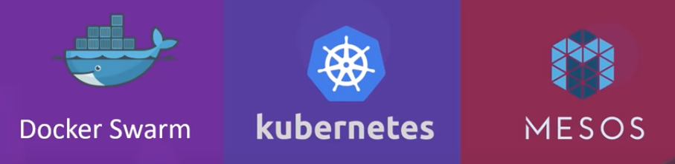
32. CONTAINER ORCHESTRATION TOOLS
Container orchestration is used to scale and monitor containers to provide appropriate service
Main container orchestration tools:

